Slide 1
LINKEDIN FOR STUDENT PLACEMENTS

Slide 2
TEAM MEMBERS
TATA RAKESH – (S300604)
SOUMITH REDDY SANIGARAM – (S306040)
AJAY KUMAR YADLAPALLI - (S305304)

Slide 3
INTRODUCTION
This web application displays all available job opportunities to every user. The user who registered as student can apply for the job. The user who registered as Recruiter can post a job opportunity. This application has search bar where user can filter the list of job opportunities with the required location or company name or job role or job type which helps user to find required job easy

Slide 4
REQUIREMENTS
Software requirements:
• SQL SERVER Express 2008 R2.
• Visual Studio Community 2015.
• Supported Operating System: Windows 10, Windows 8.1, Windows 8, Windows7 SP 1, Windows Server 2012 R2, Windows Server 2012, Windows Server 2008 R2 SP1.
Hardware requirements:
• 1.6 GHz or faster processor
• 1 GB of RAM (1.5 GB if running on a virtual machine)
• 10 GB of available hard disk space.

Slide 5
REQUIREMENTS
Functional requirements
The web application shall
• Initiate the signup process.
• Verify the email address used registration for genuine users.
• Allow the recruiter to post the placements.
• Allow the recruiter to post all the requirements needed for the job.
• Allow the students to search for the placements.
• Not allow the non registered users to post a job.
• Allow the registered students to apply for the job.
• Allow the users both students and recruiter to sign out.

Slide 6
REQUIREMENTS
Non-Functional requirements
• The web application should be easy to use and the search process should be accurate.
• The web application should be available all time.
• Details of the users should be secured in the web application.
• The web applications ought to have the capacity to keep up the immense dataset.
• Response times for search jobs and post jobs in web application should be less.

Slide 7

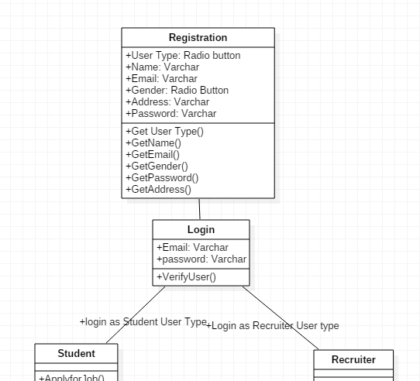
UML DIAGRAM
CLASS DIAGRAM

Slide 8
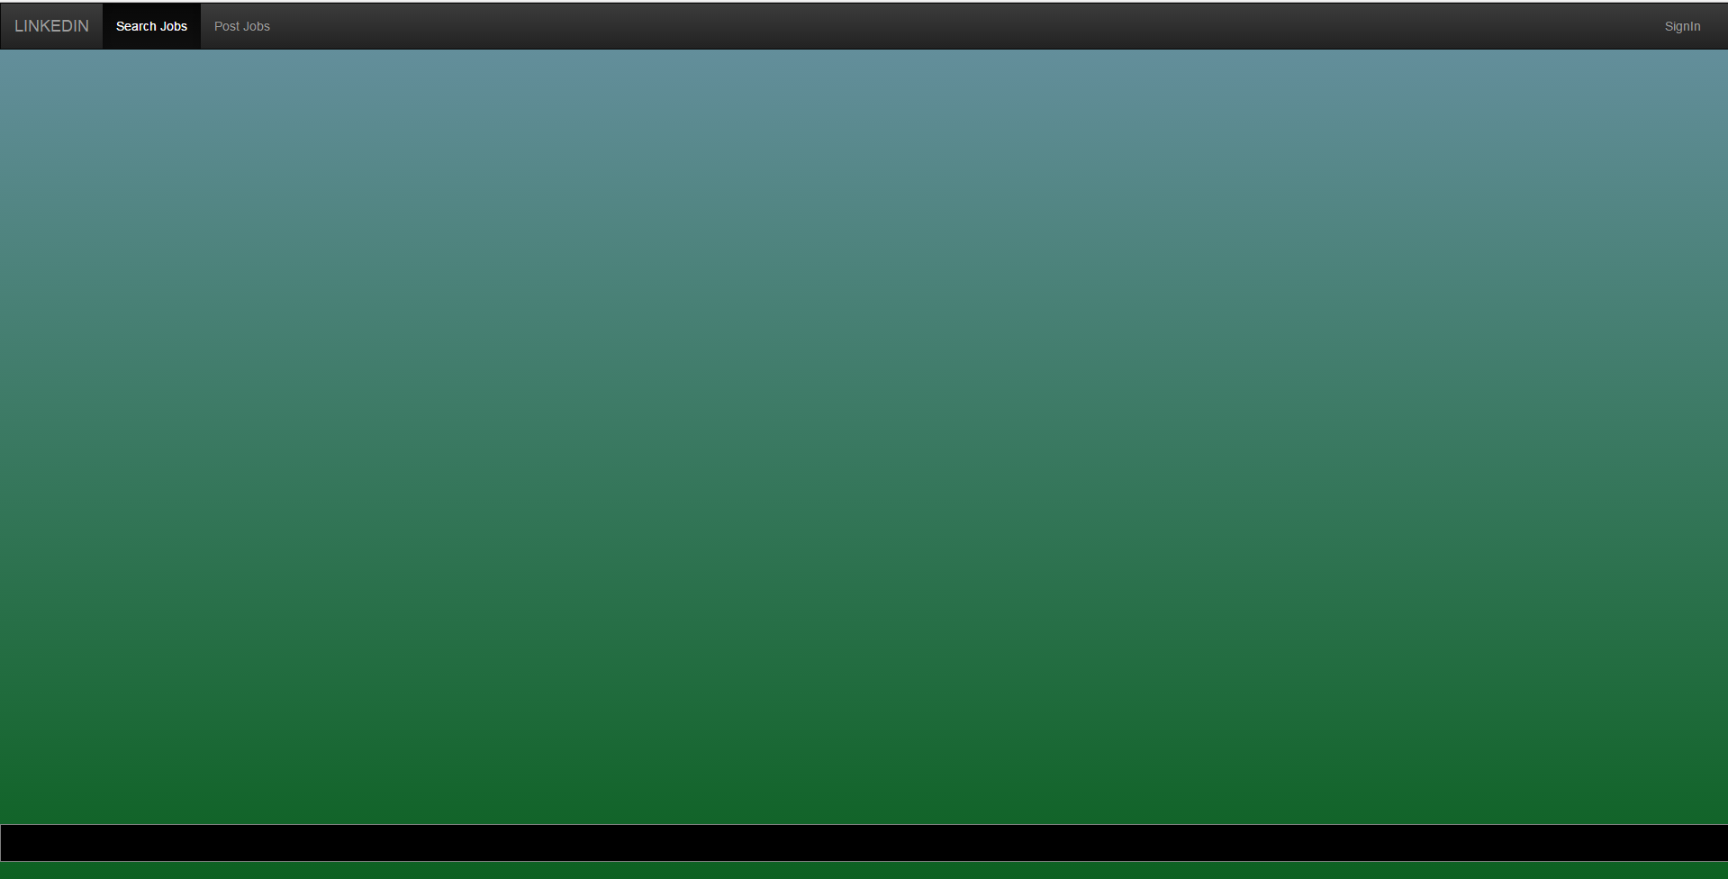
Linkedin – Home Page

Slide 9
Description
In navigation bar we have 3 sections
1) Search Job- accessible to all users
2) Post Job- accessible to users registered as Recruiter
3) SignIn- accessible to all users

Slide 10
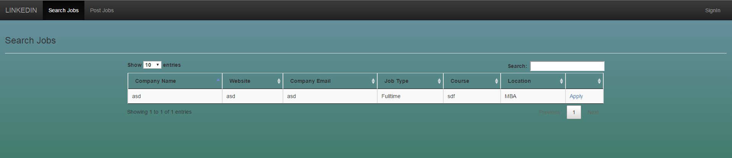
Search Job Page
Description:
-All the available opportunities are displayed for all users in the form of table.
-If clicked on Apply link, it will prompt for login.
-As soon as the recruiter posts an Job in Post Job page, the data will be displayed in this page with apply link .This link can only be accessed by the user registered as student.

Slide 11
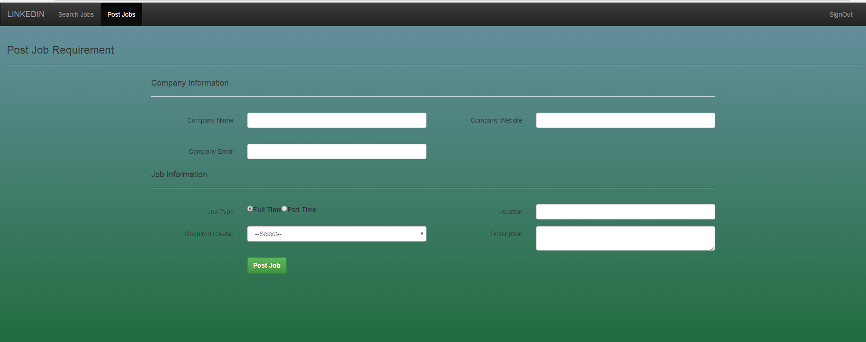
Post Job Page

Slide 12
Description
-Form for posting a job is displayed. -This form can only submitted by the user who is registered as recruiter. -User registered as student or non registered user cannot submit this form. -If the form is submitted in this page then the data will be displayed in ‘Search Job’ page.

Slide 13
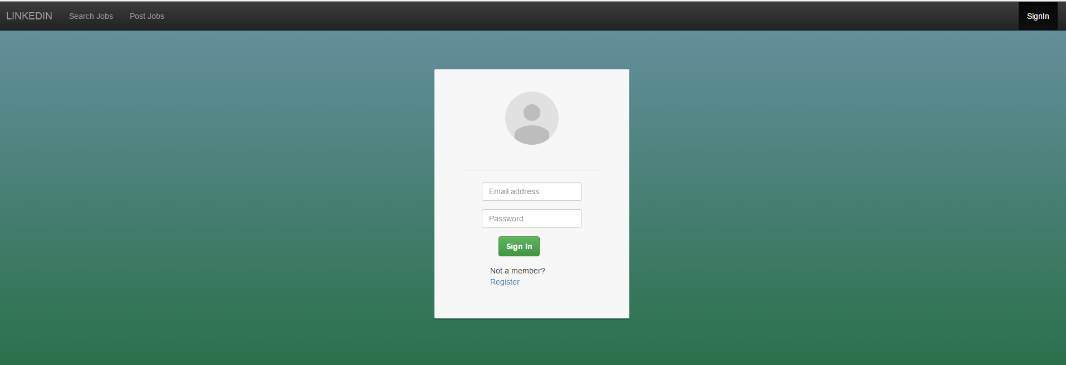
Login Page
Registered should enter email & password , Non registered should click on Register Link.

Slide 14
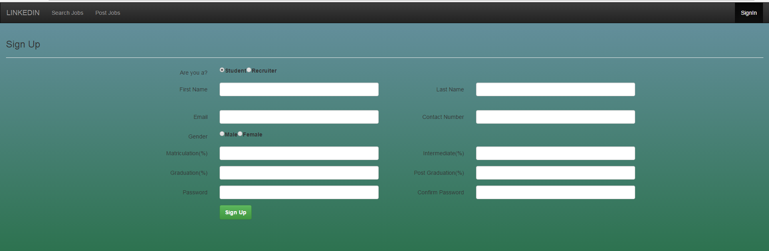
Student Registration Page

Slide 15
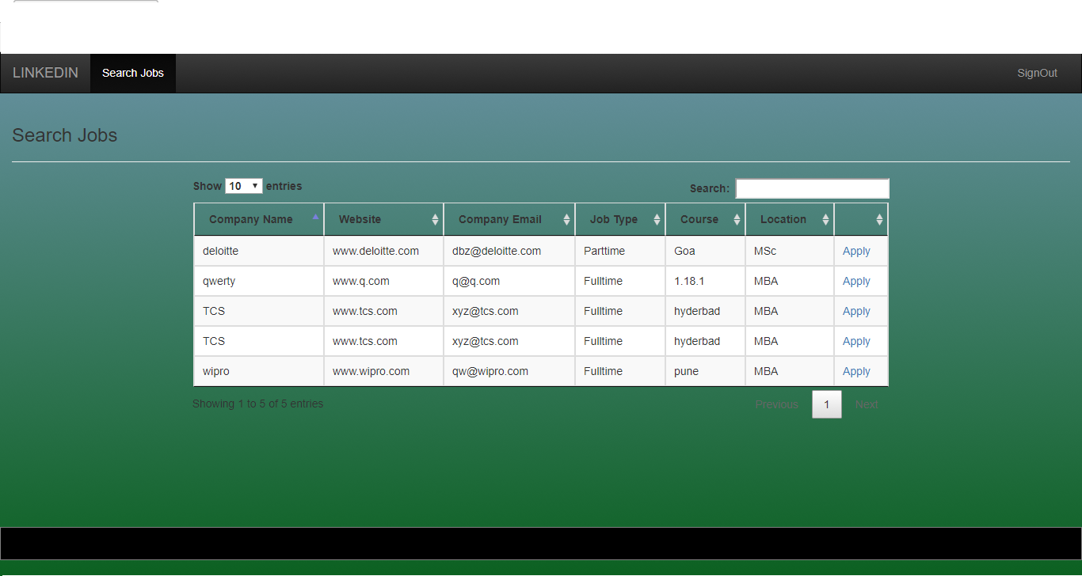
Jobs Posted For Students

Slide 16
Description
-Registration form is displayed. -Here user can register as either recruiter or Student. -Respective forms are displayed for recruiter and Student. -If user is registered as recruiter then he can post an job in Post Job Page after registration.
- If user is registered as student then he can apply for job in Search Job Page.

Slide 17
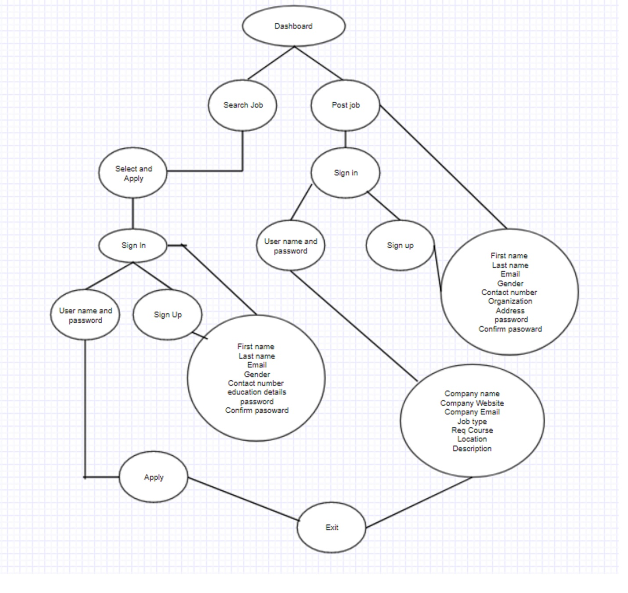
ER DIAGRAM

Slide 18
Database Design Description.
We have used three tables in this web application.
tblUser : Contains user details (Registration Page)
tblJobDetail: Contains Job Details Posted in PostJob Page by recruiter
tblJob_User: This table contains userID(tblUser) and JobID(tblJobDetail).In this table we can know how many jobs (with jobIID’s) does an user applied.

Slide 19
TESTING
Negative Testing:
Tested Scenarios:
• To verify non- registered user can apply / post an job.(Non registered user cannot apply/post Job)
• To verify Registered User(Student) can Post an Job (Student cannot Post an Job).
• To verify Registered User(Recruiter) can apply for Job (Recruiter cannot apply for an job).

Slide 20
TESTING
Positive Testing:
Tested Scenarios:
• To verify non- registered user can Search for job.
• To verify Registered User(Recruiter) can Post an Job.
• To verify Registered User(Student) can apply for Job.

Slide 21
THANK YOU

